Slide 1



VOIS Innovation
Marathon 2.0

Slide 2




Project Title: FraudLens: AI-Powered Fraud Detection System for Government Scheme Integrity
Insert your professional photo
Krishnadas Lamdade
(E&TC)
Team No. 44
Insert your professional photo
Insert your professional photo
Keystone School of Engineering,Pune, maharashtra
Ganesh Ketiboyana
(E&TC)
Shreyash Jagtap
(E&TC)

Slide 3
Problem Statement
Government welfare schemes face issues such as identity fraud, duplicate applications, and document tampering, resulting in misuse of funds and loss of benefits for genuine citizens. Existing manual and isolated verification systems are slow and error-prone creating the need for a secure, transparent, and unified solution to detect fraud and ensure fair benefit distribution.

Slide 4
Need of Project
🔹 Increase in Digital Fraud: Growing number of fake documents and duplicate applications in online government schemes.
🔹 Document Tampering Issues: Edited Aadhaar/PAN cards are used to misuse benefits and commit identity fraud.
🔹 Duplicate Benefit Claims: Same person applying multiple times using same or manipulated details.
🔹 Lack of Transparency: No proper tracking system to maintain immutable records of applications.
🔹 Need for Smart Automation: Requirement of AI-based document verification and fraud detection.
🔹 Secure Record Keeping: Need for blockchain-based tamper-proof storage of verification logs.
🔹 Real-Time Fraud Detection: System required to instantly reject suspicious or manipulated applications.

Slide 5
Proposed Solution
Solutions
1. AI-Powered Document Verification: Automatically detects tampered or fake Aadhaar & PAN documents with confidence scoring
2. Real-Time Fraud Prevention: Instantly rejects suspicious, duplicate, or manipulated applications before approval.
3. Blockchain-Based Transparency: Stores verification logs securely to ensure tamper-proof and trustworthy records.
4. Faster & Accurate Processing: Reduces manual effort, saves time, and improves overall verification efficiency.
Value Proposition
1. Smart AI Verification – Automatically analyzes Aadhaar and PAN documents to detect tampering, fake uploads, and mismatched details.
2. Instant Fraud Detection – Identifies duplicate applications, suspicious attempts, and invalid data in real time.
3. Secure & Transparent Records – Uses blockchain logging to maintain tamper-proof verification history.
4. Time & Cost Efficiency – Reduces manual verification workload and speeds up application processing with high accuracy.

Slide 6
Solution Overview
1. User Application Submission – Users submit personal details along with Aadhaar and PAN documents through a secure web portal.
2. AI-Based Document Analysis – System verifies document type, detects tampering, and extracts key information using AI.
3. Validation & Fraud Checks – Performs duplicate detection, format validation, and mismatch analysis in real time.
4. Blockchain Logging – Stores verification results securely to ensure transparency and tamper-proof records.
5. Dashboard Monitoring – Provides admin dashboard with fraud alerts, statistics, and application tracking.

Slide 7

Technology used
1
Frontend: HTML, CSS, Bootstrap, EJS
2
Backend: Node.js, Express.js
3
Database: MongoDB
4
Authentication and Security: Passport.js, Express-session, Flash messages
5
File Handling: multer (for document uploads)
5
6
AI (API) – Performs document analysis, tampering detection, and data extraction

Slide 8
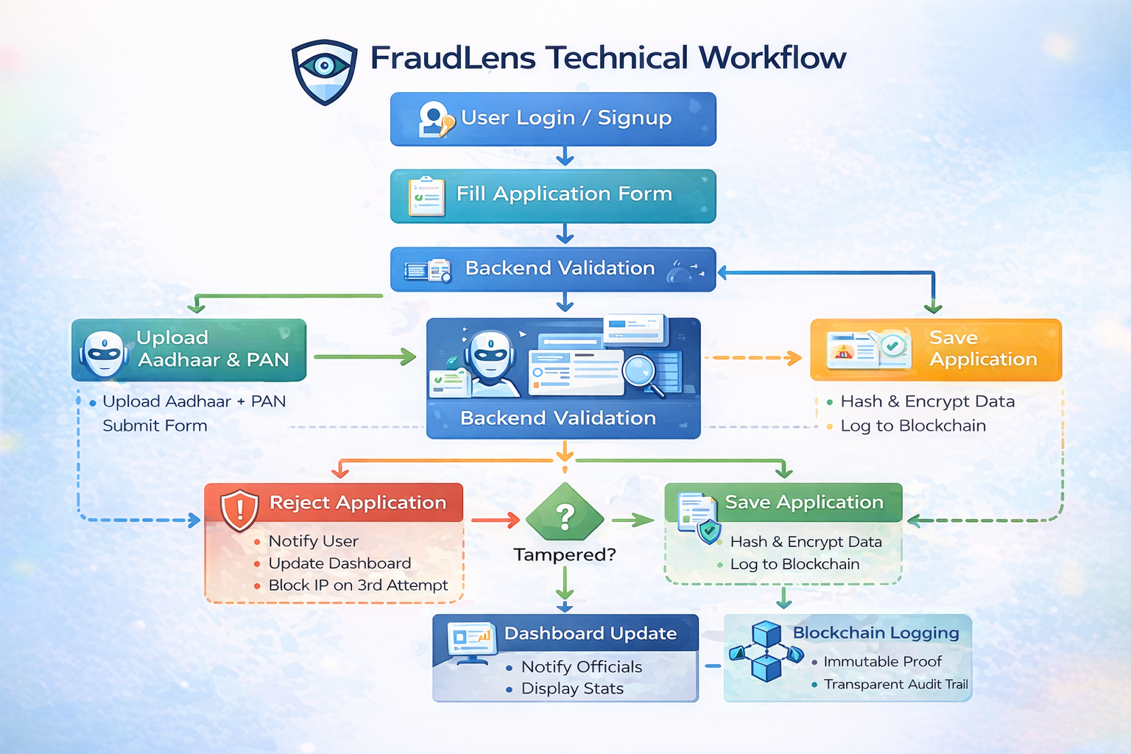
Technical flow diagram -

Slide 9
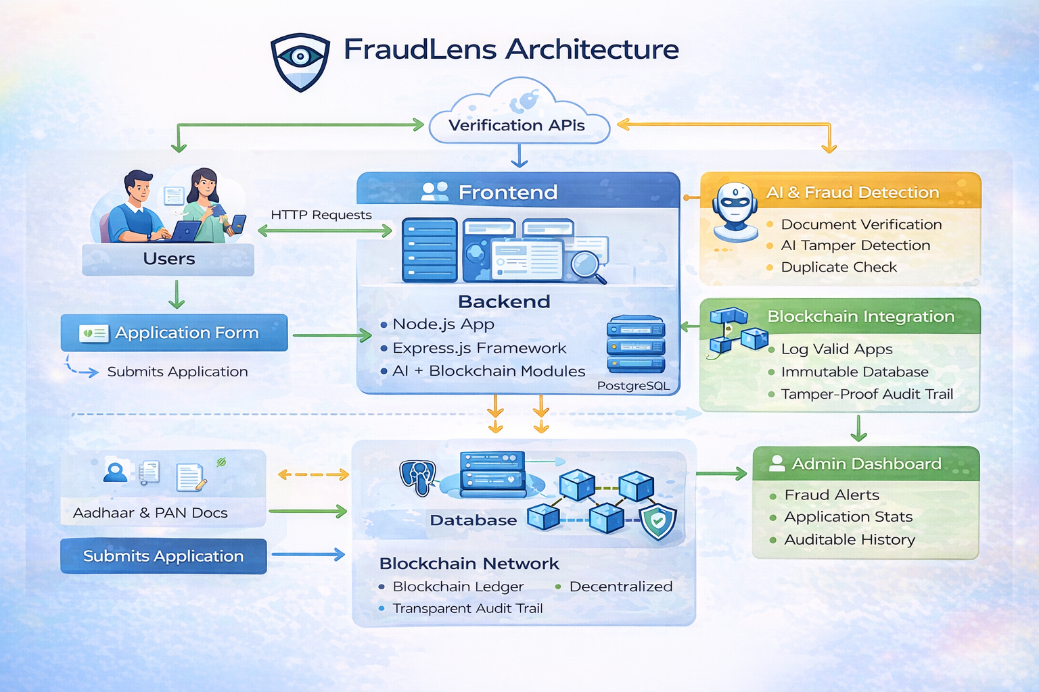
Architecture Blueprint

Slide 10
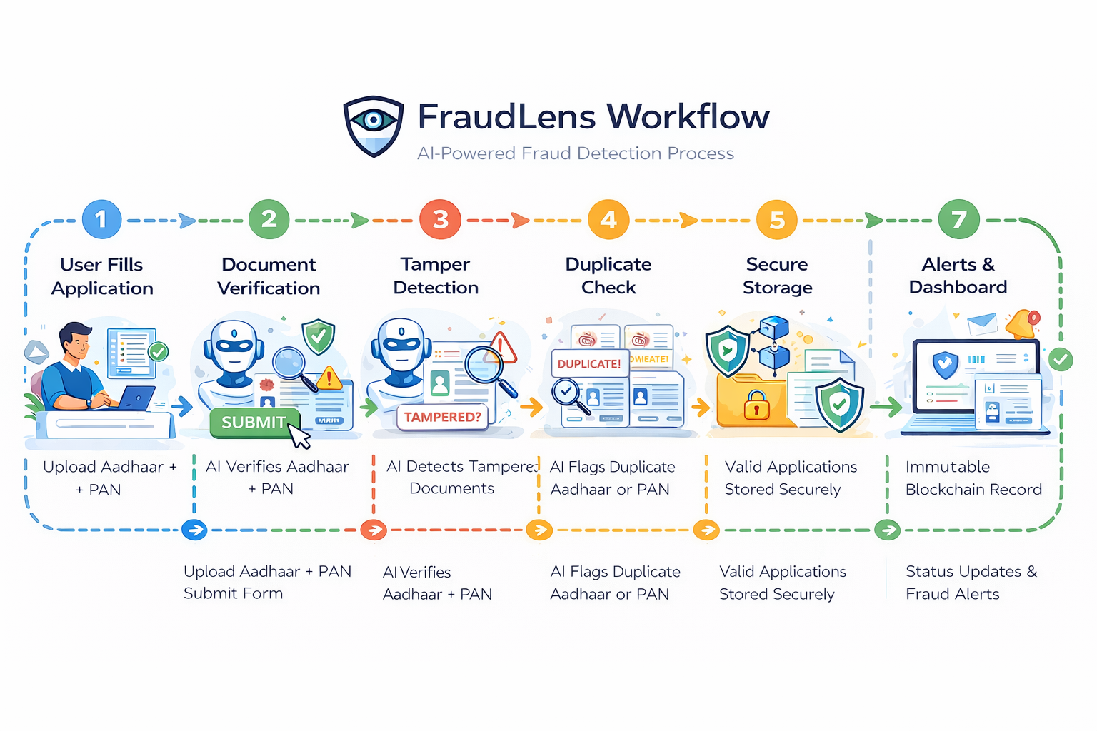
Workflow diagram

Slide 11
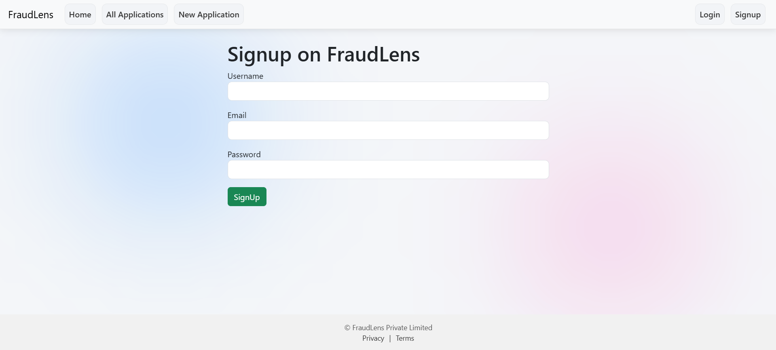
Result of our project -
1. Signup Page
Allows new users to securely register using username, email, and password
Acts as the entry point for authorized access to the fraud detection system
Ensures only authenticated users can submit and track welfare applications

Slide 12
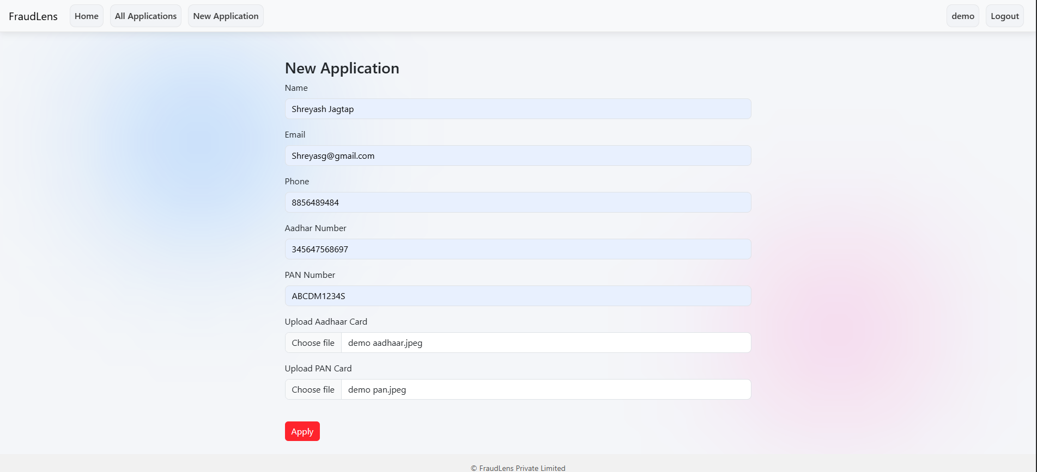
Result of our project -
2. Application Form
This screen allows authenticated users to submit a new welfare application by entering personal and identity details.
Aadhaar and PAN details along with document uploads are collected for verification and fraud detection.
The form acts as the first checkpoint where duplicate or fraudulent applications are identified before submission.

Slide 13
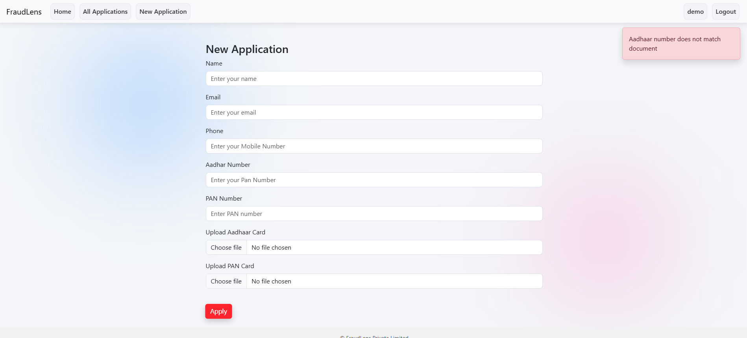
Result of our project -
3. Fraud Suspected
Displays the application
form with input fields
for Aadhaar, PAN, and
personal details.
Shows real-time validation
error(e.g., “Aadhaar
number does not
match document”).
Prevents submission
if document verification
or data matching fails.

Slide 14
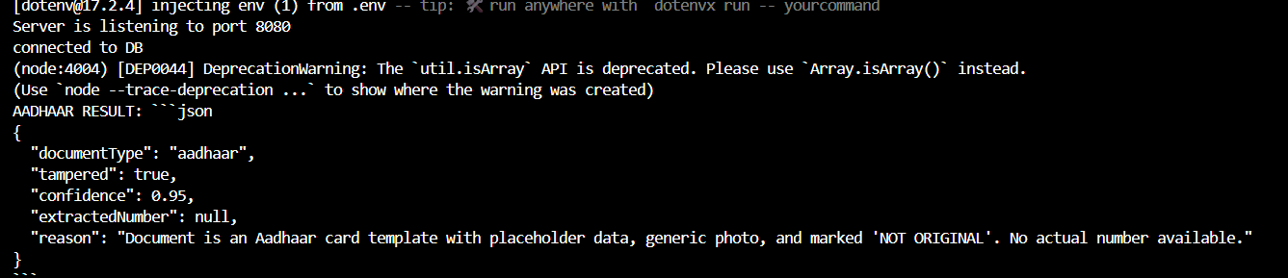
Result of our project -
4. AI Fraud Detection
AI detected the uploaded
file as an Aadhaar card.
System flagged the document
as fake/modified with
high confidence.
AI could not find a
valid Aadhaar number
in the image.
Document appears to be
a sample/template marked
“NOT ORIGINAL”, so
application is rejected.

Slide 15
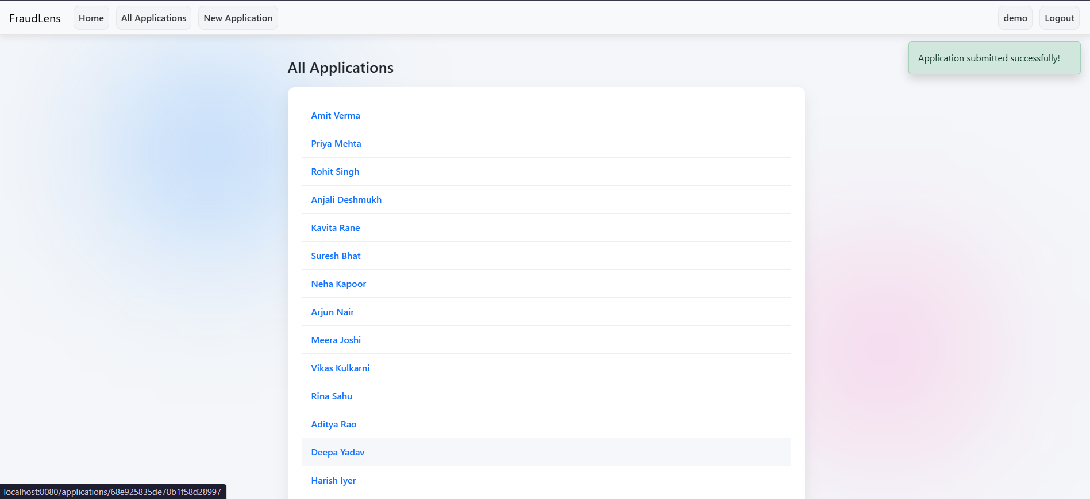
Result of our project -
5. Application Submitted Successfully and Stored in All Applications Page
Displays a list of all
submitted applications
in the system.
Each applicant’s name
is clickable to view full
details and verification status.
Helps admin review, track,
and monitor fraud
detection results.
Shows success message
after a new application
is submitted.

Slide 16
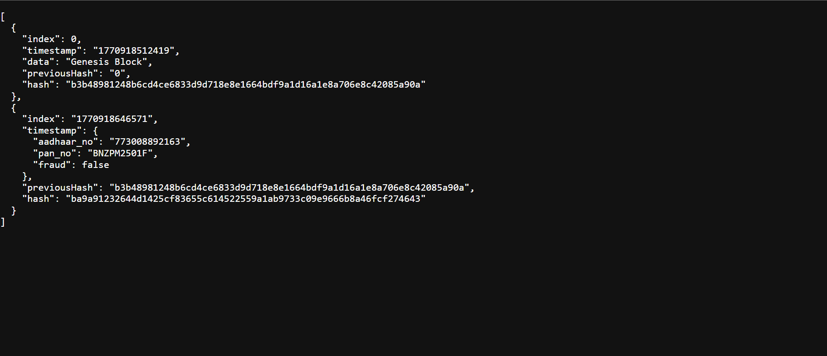
Result of our project -
6. Blockchain Working
This screen shows the live blockchain ledger used in the FraudLens system.
Each application submission creates a new immutable block containing hashed Aadhaar and PAN details.
The linkage of blocks using previous Hash ensures data cannot be altered, providing tamper-proof auditability.

Slide 17
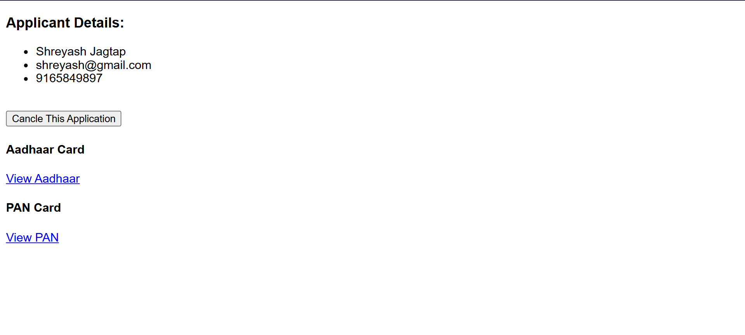
Result of our project -
8. Application Details
Shows name, email and
mobile number of the
applicant.
Provides options to
view uploaded
Aadhaar and PAN card.
“Cancel This Application”
button allows admin/user
to withdraw the application.
Used for reviewing and
validating submitted
application details and document.

Slide 18
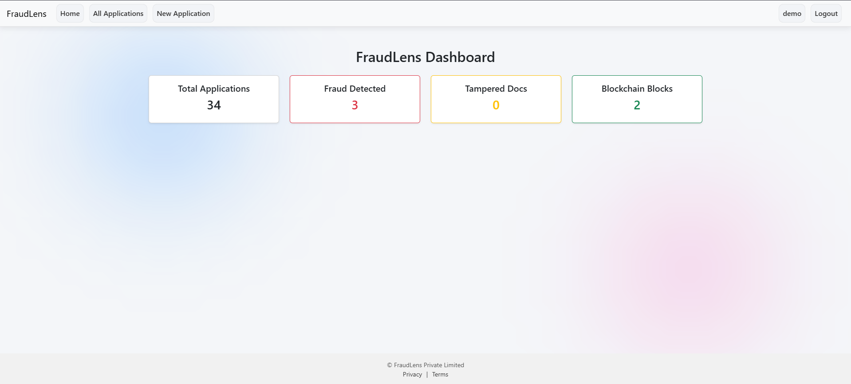
Result of our project -
9. Dashboard
Displays real-time statistics of total applications submitted in the system
Shows the number of fraud cases detected to help authorities monitor misuse
It shows total tampered documents identified
Tracks total blockchain blocks to reflect transparency and immutable records

Slide 19

Role of Agentic AI and Gen AI in the solution
Role of Generative AI
Analyzes uploaded Aadhaar and PAN card images.
Detects document tampering or digital manipulation.
Extracts document details (number, type) from images.
Generates structured verification results (tampered, confidence score, reason).
Role of Agentic AI
Automates multi-step verification process (validation → AI check → duplicate check → fraud flag).
Continuously monitors repeated attempts from same IP/device.
Assigns dynamic fraud risk status based on behavior patterns.
Assigns dynamic fraud risk status based on behavior patterns.

Slide 20
Novelty and Uniqueness
1
2
3
4
1. AI + Document Intelligence Integration – Uses Generative AI to verify document type, detect tampering, and extract data automatically.
2. Real-Time Data Matching System – Compares entered Aadhaar/PAN numbers with extracted document data instantly to prevent fraud.
3. Blockchain-Based Audit Trail – Each verified application is logged into blockchain for secure, tamper-proof record keeping.
4. Multi-Layer Fraud Detection Engine – Combines validation checks, duplicate detection, IP tracking, and AI analysis for stronger fraud prevention.

Slide 21
Git Hub Link
https://github.com/KDas2004/FraudLens-AI-Powered-Detection-System-for-Government-Scheme-Integrity-.git

Slide 22
Future Scope
Multi-Layer Fraud Detection Engine – Combines validation checks, duplicate detection, IP tracking, and AI analysis for stronger fraud prevention.
Advanced Face Verification – Add facial recognition to match applicant’s selfie with Aadhaar photo.
Mobile Application Version – Launch Android/iOS app for wider accessibility and faster adoption.
Machine Learning Risk Scoring – Develop a predictive fraud scoring model based on user behavior patterns.
Multi-Document Support – Extend verification to Passport, Driving License, Voter ID, and other official documents.

Slide 23
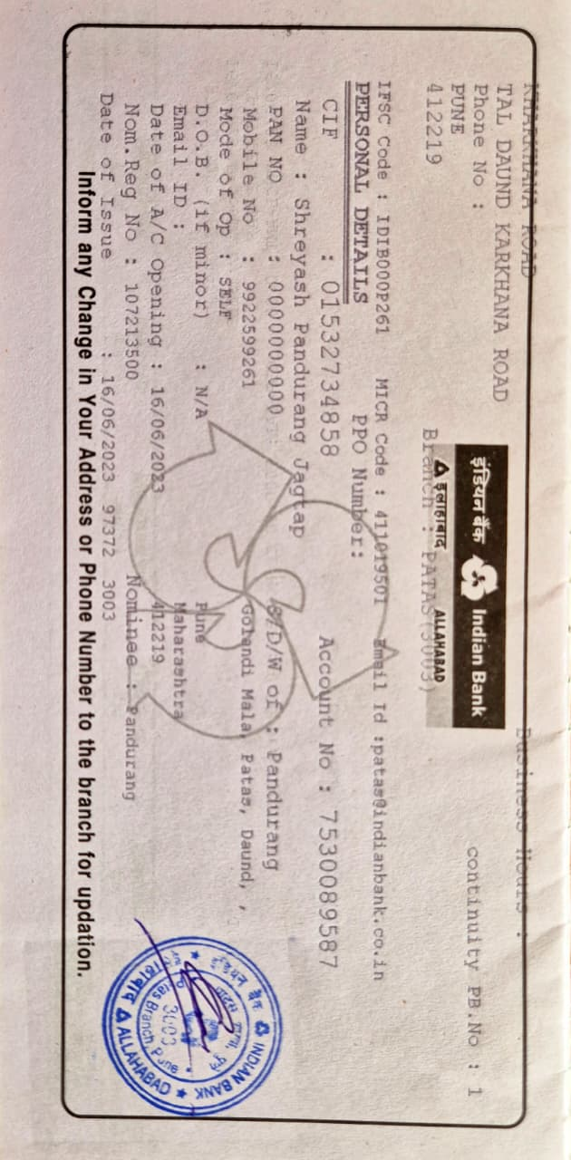
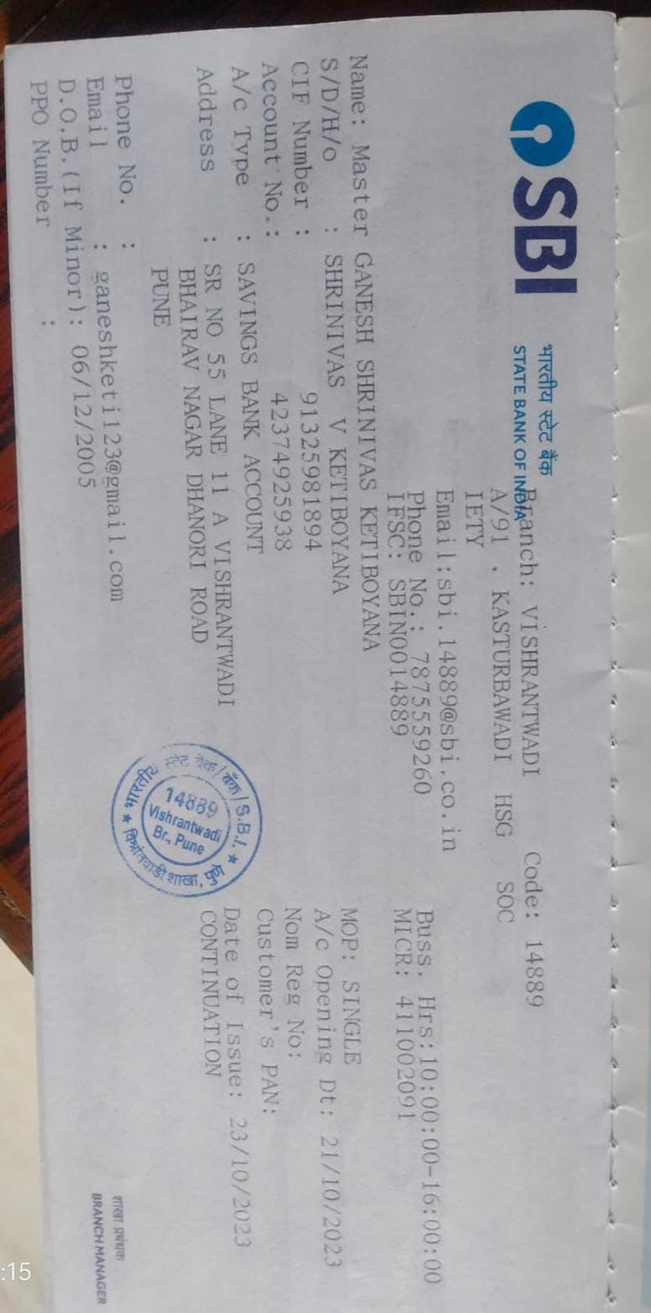
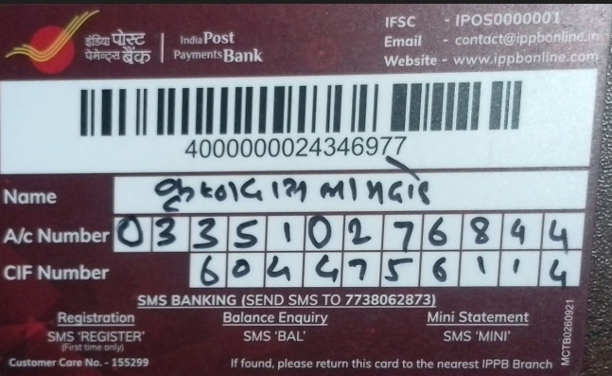
Bank Details
Full Name (as per bank records): | Bank Name | Branch Name | Account Number | Account Type (Savings / Current) | IFSC Code
Krishnadas Lamdade | India Post Payments Bank | Nanded | 033510276844 | Savings | IPOS0000001
Ganesh Ketiboyana | SBI bank | Vishrantwadi | 42374925938 | Savings | SBIN0014889
Shreyash Pandurang Jagtap | Indian Bank | PATAS | 7530089587 | Savings | IDIB000P261
Insert photo of passbook / bank statement
Team Member 1 Passbook/ Bank Statement With Name and Account Number
Team Member 2 Passbook/ Bank Statement With Name and Account Number
Team Member 3 Passbook/ Bank Statement With Name and Account Number

Slide 24
Thank You

